Slide 1

DEPARTMENT OF ARTIFICIAL INTELLIGENCE AND MACHINE LEARNING
20AM8201 - PROJECT WORK
Batch - 01
Presented by :
Guided by :
ADEEBA AAISHA F - 811722001001
DHARSHINI R - 811722001009
HARINI S - 811722001013
SHALINI V - 811722001045
Dr .T.AVUDAIAPPAN,
Professor/AI

Slide 2
AN INNOVATIVE CLINICAL DECISION SUPPORT FRAMEWORK FOR DIABETES BASED ON DEEP AND ENSEMBLE DEEP LEARNING

Slide 3
RESEARCH OBJECTIVE
To develop a clinical decision support system for diabetes using deep learning models to accurately predict and classify diabetes conditions from patient data.
To improve prediction performance by combining multiple deep learning models (ensemble approach), reducing errors compared to single models.
To support doctors in early diagnosis and treatment decisions by providing reliable, data-driven insights in a simple and efficient manner.

Slide 4
RESEARCH QUESTIONS
Can deep learning models accurately predict diabetes using clinical patient data?
Does an ensemble of deep learning models perform better than a single deep learning model in diabetes prediction?
Can the proposed clinical decision support system assist healthcare professionals in making faster and more reliable decisions?

Slide 5
FRAMEWORK - PICO
Population: Patients with clinical data related to diabetes (e.g., blood glucose, BMI, age, medical history).
Intervention: Deep learning–based clinical decision support system using ensemble deep learning models.
Comparison: Traditional machine learning methods or single deep learning models.
Outcome: Improved accuracy and reliability in diabetes prediction and clinical decision-making.

Slide 6
LITERATURE SURVEY
Literature Survey Link

Slide 7
SYNTHESIS & SUMMARIZATION
Recent research in diabetes prediction focuses on developing accurate and reliable clinical decision support systems using deep learning and ensemble deep learning models for clinical use.
Common datasets: PIMA Indian Diabetes Dataset, sample sizes range from hundreds to a few thousand records.
Popular algorithms: Deep Neural Networks (DNN), CNN, LSTM, hybrid deep learning models, and ensemble deep learning approaches.

Slide 8
Purpose: To accurately predict diabetes and support clinicians in making better and faster diagnostic decisions.
Challenges:
Limited availability of large and diverse clinical datasets
High computational complexity of deep and ensemble models
Risk of overfitting when data size is small
Difficulty in deploying models in real-time clinical environments

Slide 9
Trends:
Growing use of ensemble deep learning to boost accuracy
Integration of clinical decision support systems in healthcare
Shift towards data-driven and automated diagnosis
Focus on making models more robust and clinically applicable.

Slide 10
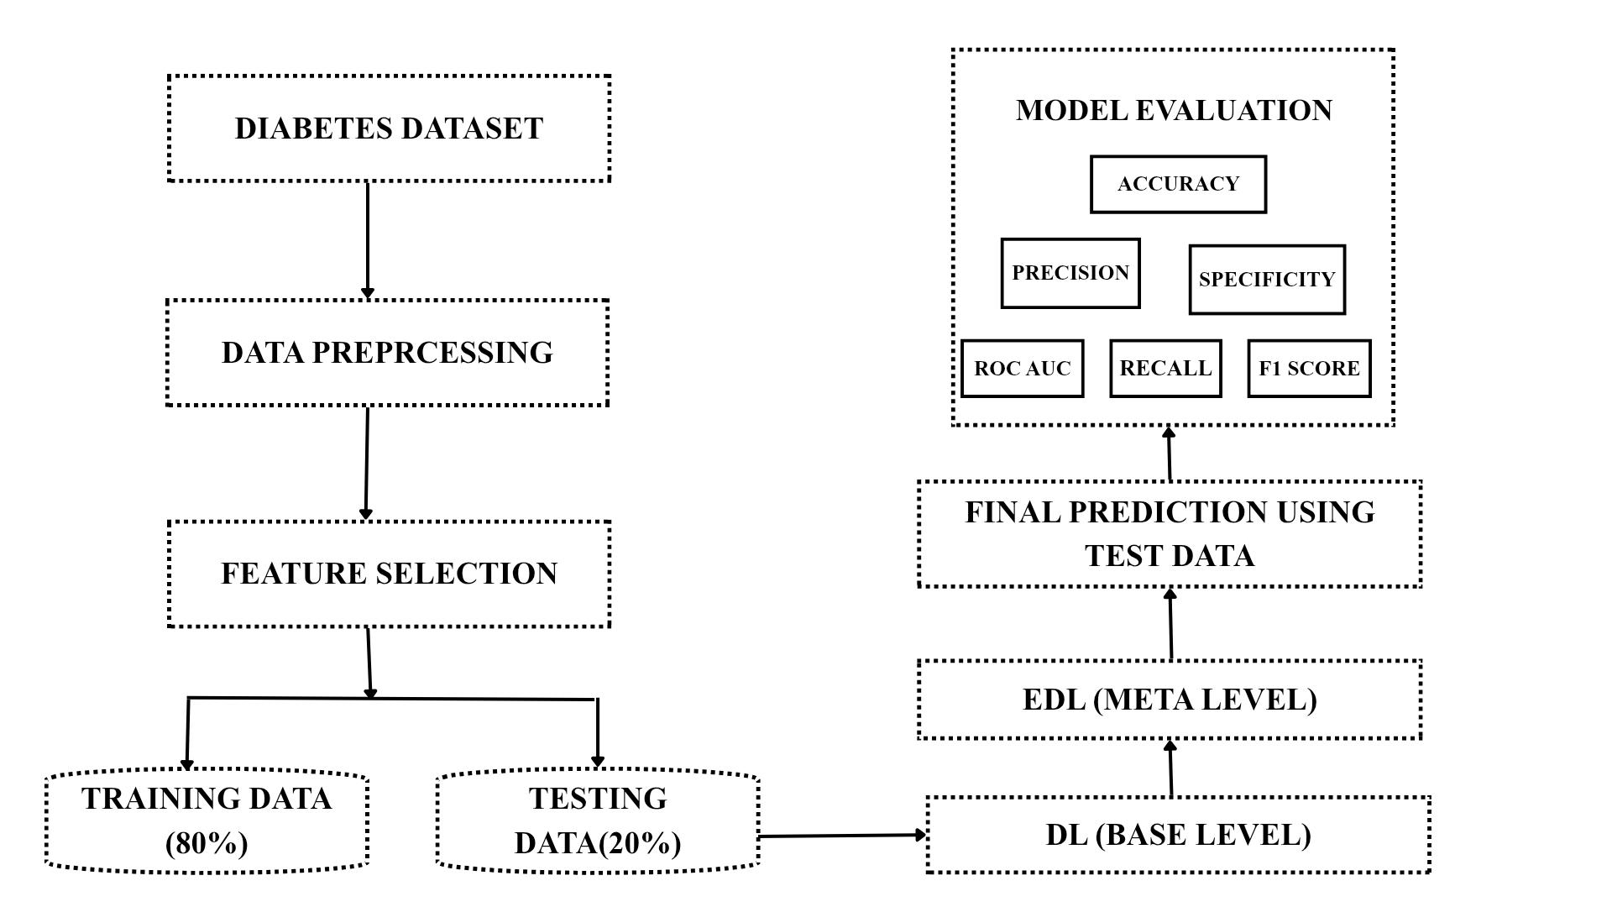
DATA FLOW DIAGRAM

Slide 11
RESEARCH GAP - METHODOLOGY GAP
Many existing diabetes prediction systems use single deep learning models, which often fail to capture complex patterns present in clinical data.
Limited prediction reliability:
Single models may give unstable results when patient data varies.
This reduces confidence for doctors when using predictions in real clinical settings.
Overfitting and generalization issues:
Models trained on small or single-source datasets may perform well in testing but poorly in real-world scenarios.
This limits their usefulness across different patient populations.

Slide 12
High model complexity:
Deep learning models require high computational power.
This makes them difficult to deploy in real-time clinical environments.
Integration challenges in healthcare systems:
Many models are developed only for research purposes.
They are not designed to easily integrate into hospital workflows or clinical decision-making processes.

Slide 13
METHODOLOGIES
Artificial Neural Network (ANN)
1D Convolutional Neural Network (1D CNN)
Long Short-Term Memory (LSTM)
Random Forest
XGBoost (Extreme Gradient Boosting)
Voting Classifier
Stacking Ensemble

Slide 14
METHODOLOGY
1.Artificial Neural Network (ANN)
ANN is used to analyze clinical diabetes data such as glucose level, BMI, age, and blood pressure.
It learns patterns from patient data to classify diabetic and non-diabetic cases.
ANN can capture complex and non-linear relationships between input features.
It acts as a base model in the proposed clinical decision support framework.
The ANN output is later combined with other models in the ensemble to improve prediction accuracy.

Slide 15
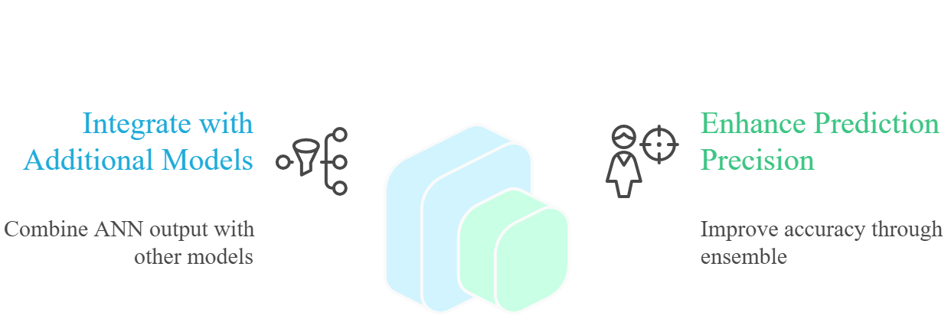

Slide 16
2.1D Convolutional Neural Network (1D CNN)
1D CNN is used to automatically extract important features from clinical diabetes data.
It applies convolution operations on one-dimensional input data such as patient health records.
The model helps identify hidden patterns and trends in diabetes-related features.
1D CNN reduces the need for manual feature selection.
It acts as an important deep learning model in the ensemble to improve overall prediction performance.

Slide 17
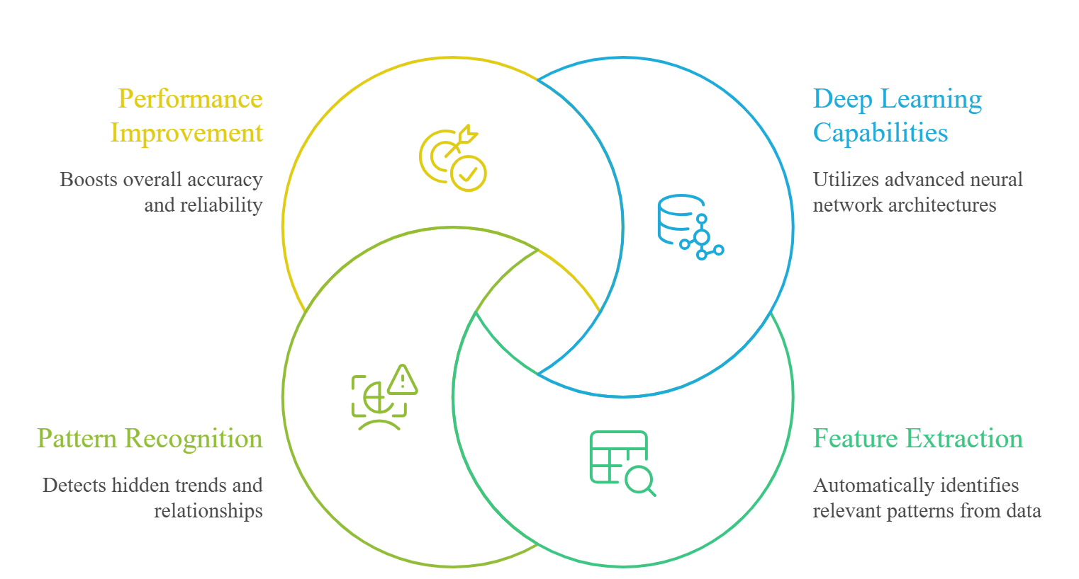

Slide 18
3. Long Short-Term Memory(LSTM)
LSTM is used to learn patterns from sequential or time-related diabetes data.
It can remember important information over longer periods, unlike basic neural networks.
LSTM helps capture relationships between past and present clinical values.
It reduces information loss while processing patient data.
LSTM acts as a deep learning model in the ensemble to improve prediction accuracy and stability.

Slide 19
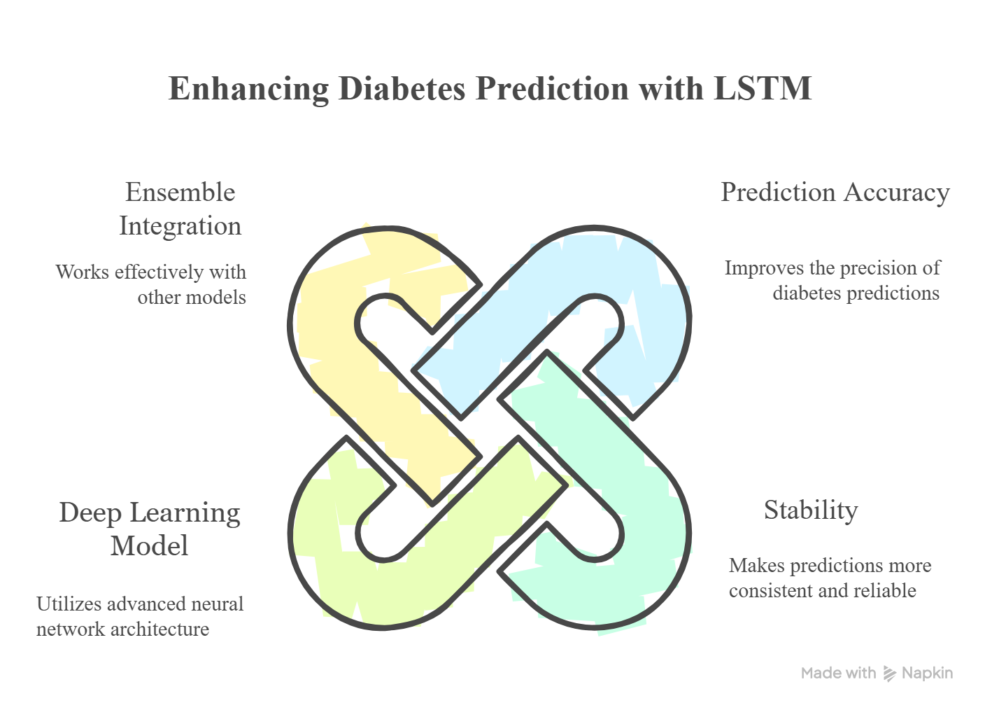

Slide 20
4.Random Forest
Random Forest is a machine learning model that uses multiple decision trees for prediction.
It reduces overfitting by averaging the results of many trees.
The model handles clinical diabetes data with high accuracy and stability.
Random Forest works well with both numerical and categorical health features.
It serves as an important base model in the ensemble framework to improve overall prediction performance.

Slide 21
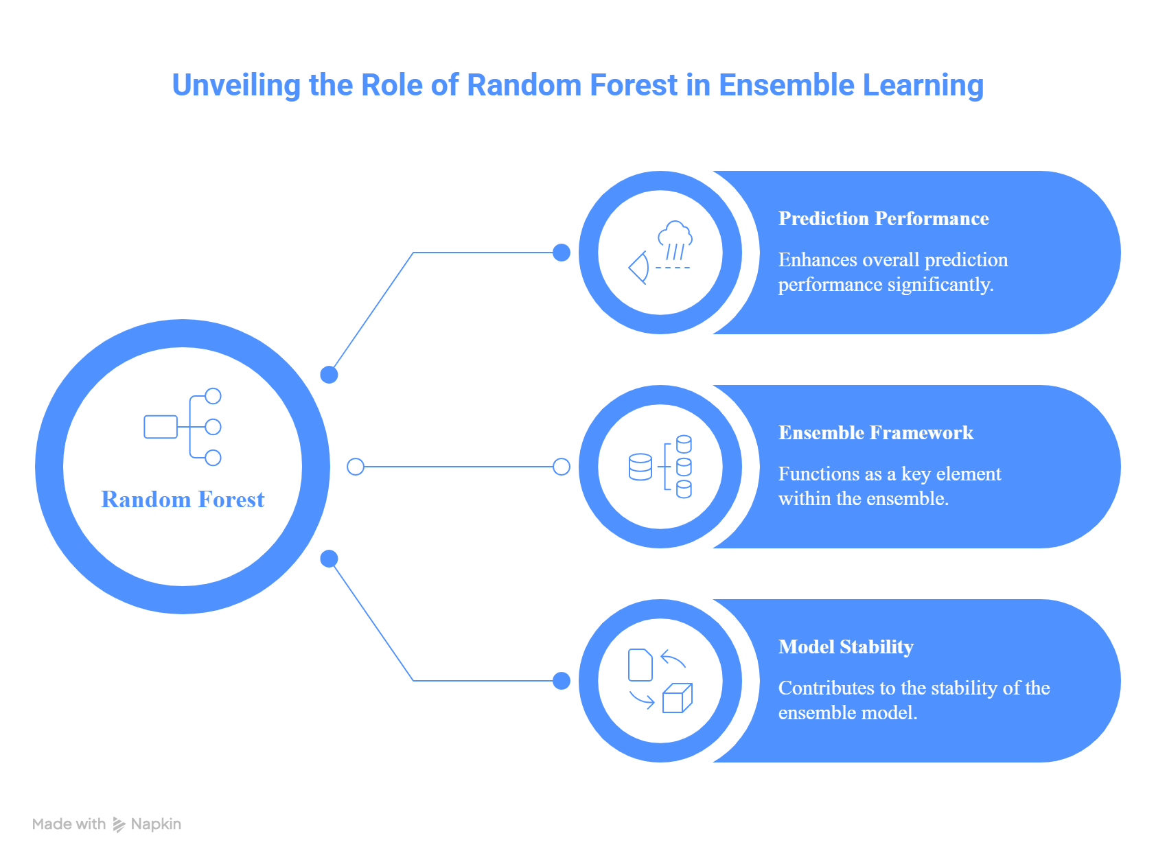

Slide 22
5.XGBoost (Extreme Gradient Boosting)
XGBoost is a powerful machine learning algorithm based on boosting techniques.
It builds models sequentially, where each new model corrects the errors of the previous one.
XGBoost handles complex diabetes data efficiently and improves prediction accuracy.
XGBoost acts as a strong base learner in the ensemble framework to enhance overall performance.

Slide 23
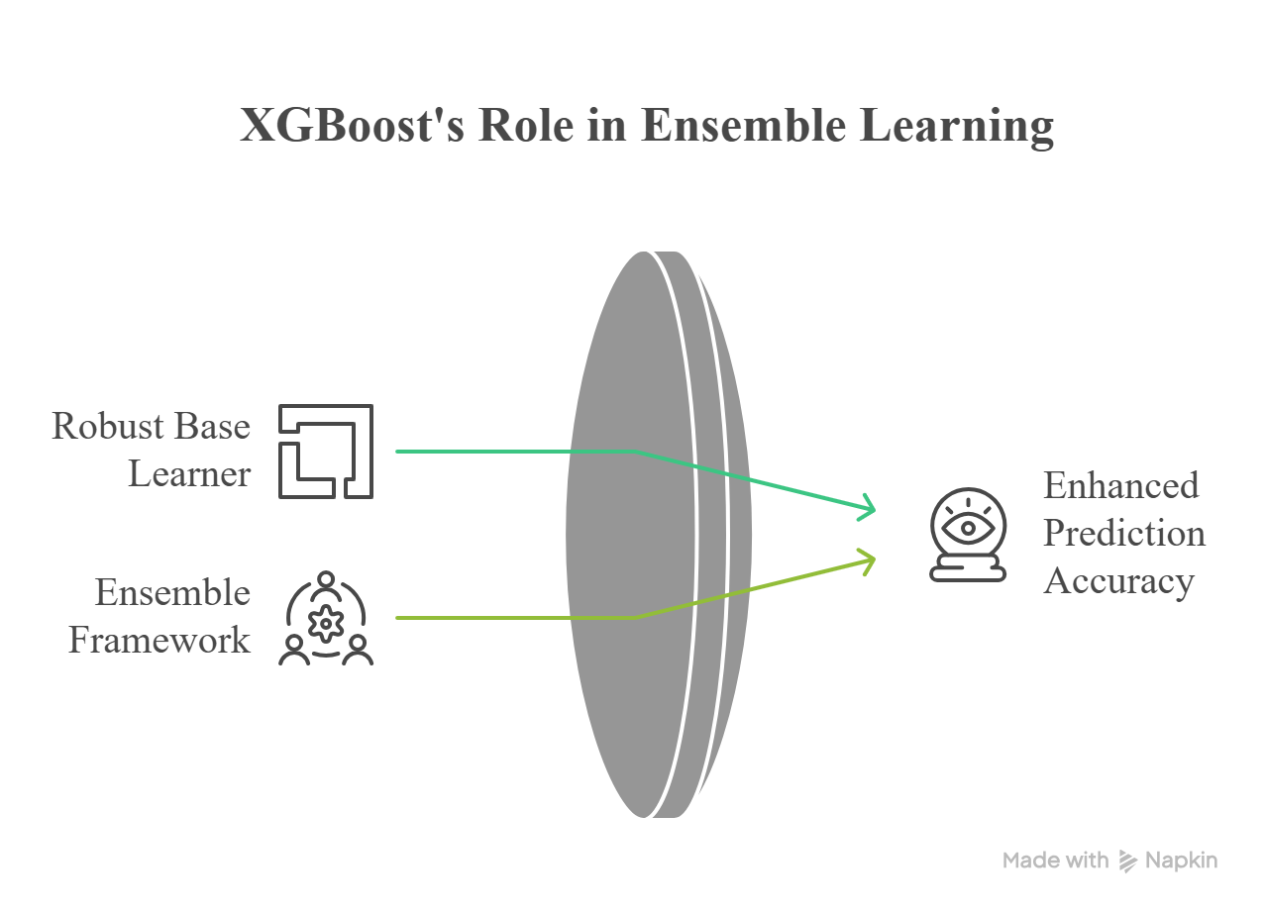

Slide 24
6. Voting Classifier
Voting Classifier combines predictions from multiple models into a single final decision.
It selects the class predicted by the majority of models (hard voting) or by average probabilities (soft voting).
This approach reduces the risk of errors from any single models.
It plays a key role in the ensemble deep learning framework for diabetes prediction.

Slide 25
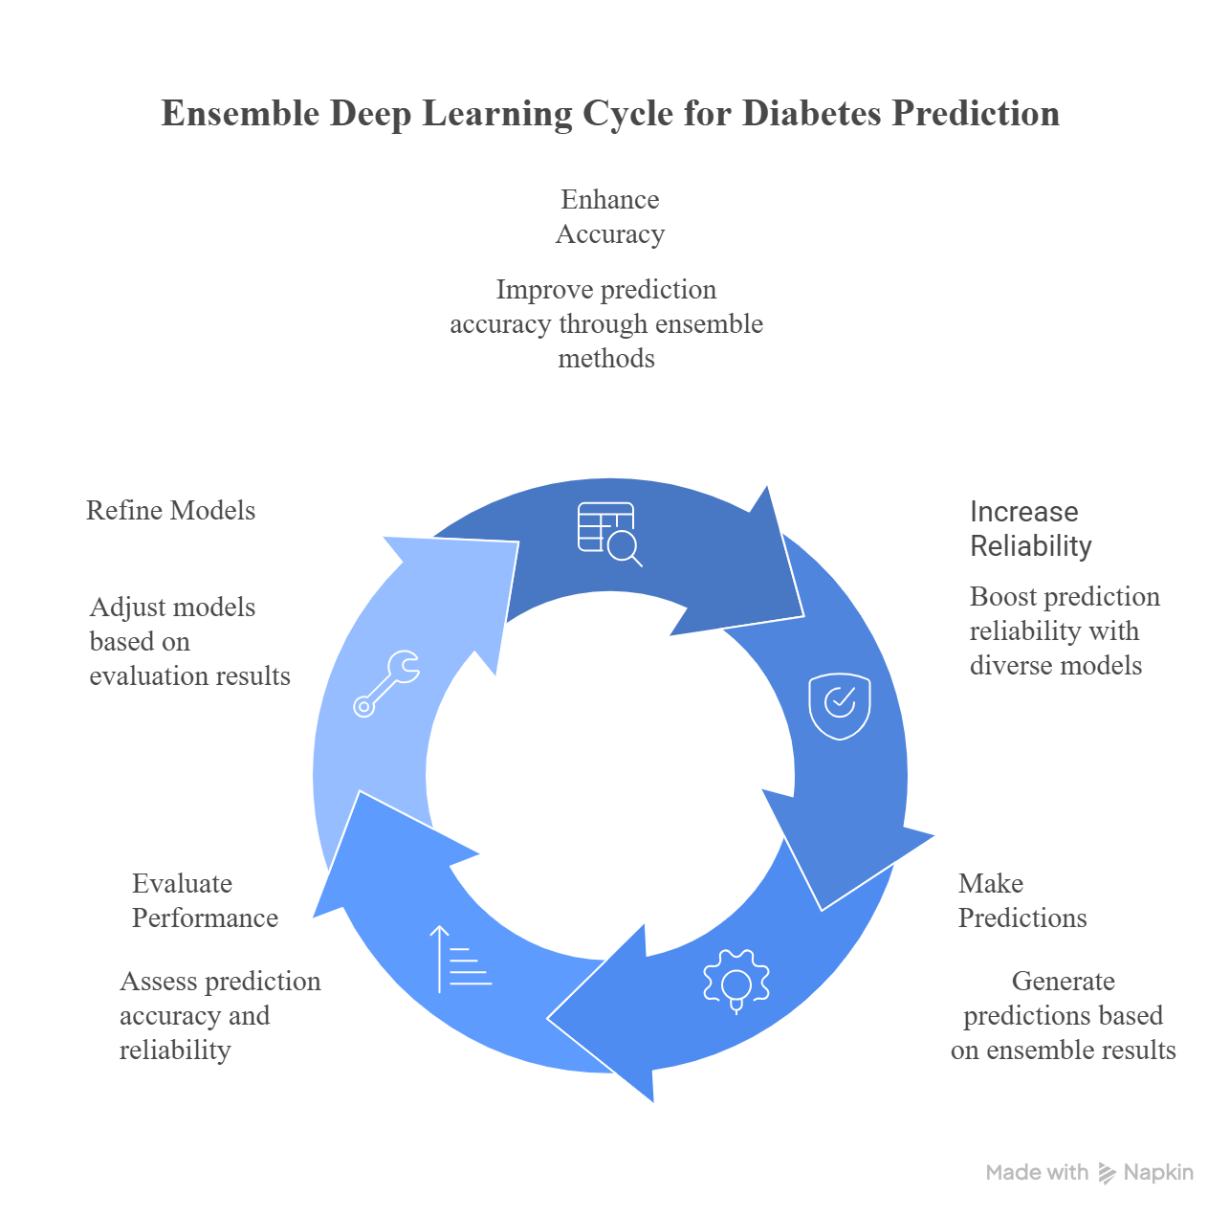

Slide 26
7. Stacking Ensemble
Stacking Ensemble combines predictions from multiple base models using a meta-model.
Base models such as ANN, 1D CNN, LSTM, Random Forest, and XGBoost generate initial predictions.
A meta-learner learns how to best combine these predictions for final output.
This approach improves overall prediction accuracy and robustness.
Stacking Ensemble strengthens the clinical decision support system by providing more reliable diabetes predictions.

Slide 27
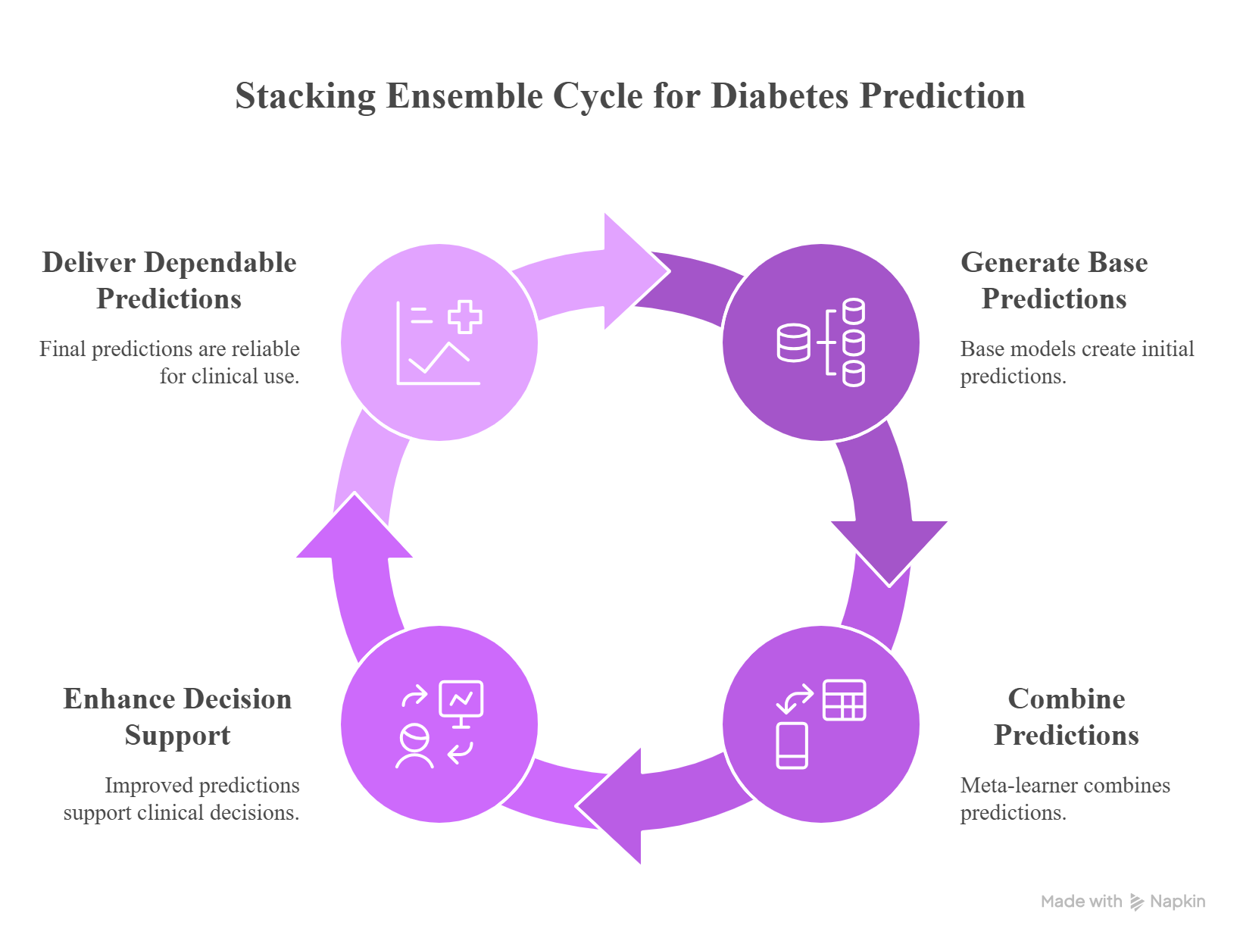

Slide 28
EVALUATION METRICS
1. Accuracy
Definition: The proportion of correctly classified instances (both positive and negative) out of the total number of cases.
Formula: Accuracy = (TP+TN) / (TP+TN+FP+FN)
Use in Diabetes Prediction: Shows the overall correctness of the model in predicting diabetic and non-diabetic patients.
Limitation: Accuracy can be misleading when the dataset is imbalanced, such as when non-diabetic cases are much more than diabetic cases.

Slide 29
2. Precision
Definition: The proportion of positive predictions that are actually correct.
Formula: Precision = TP / (TP+FP)
Use in Diabetes Prediction: Precision indicates how many patients predicted as diabetic are actually diabetic, helping reduce false positive diagnoses.
Example: If the model predicts 100 patients are diabetic, but only 80 patients actually have diabetes, then the precision is 80%.

Slide 30
3. Recall (Sensitivity / True Positive Rate)
Definition: The proportion of actual positive cases that are correctly identified by the model.
Formula: Recall = TP / (TP+FN)
Use in Diabetes Prediction: Recall measures how well the model identifies actual diabetic patients and helps reduce missed diabetes cases.
Example: If there are 100 actual diabetic patients and the model correctly identifies 90 of them, then the recall is 90%.

Slide 31
4. F1-Score
Definition: The harmonic mean of precision and recall.
Formula: F1 = 2×(Precision×Recall / Precision+Recall)
Use in Diabetes Prediction: F1-score balances precision and recall, giving a single measure of model performance when both false positives and false negatives matter.
Example: If a diabetes prediction model has high precision and high recall, the F1-score will also be high, indicating reliable overall performance.

Slide 32
5. ROC-AUC (Receiver Operating Characteristic – Area Under the Curve)
Definition: Measures a model’s ability to distinguish between classes across all possible classification thresholds.
Interpretation:
AUC = 1.0 → Perfect classifier
AUC = 0.5 → No better than random guessing
Use in Diabetes Prediction : ROC–AUC measures how well the model distinguishes between diabetic and non-diabetic patients across different classification thresholds.

Slide 33
6. Confusion Matrix
Definition: A table used to evaluate the performance of a classification model by comparing actual values with predicted values.
Formula: Accuracy = (TP + TN) / (TP + TN + FP + FN)
Use in Diabetes Prediction: The confusion matrix helps analyze how well the model predicts diabetic and non-diabetic patients by showing correct and incorrect predictions.
Example: If a diabetes prediction model correctly identifies most diabetic patients (True Positives) and healthy patients (True Negatives) while minimizing False Positives and False Negatives, the confusion matrix indicates strong model performance.

Slide 34
DATA COLLECTION AND ANALYSIS
Data Collection

Slide 35
MODULES
Data Collection Module
Data Preprocessing Module
Model Training Module
Ensemble Model Module
Prediction Module
Dashboard & Visualization Module
Firebase Integration

Slide 36
MODULES DESCRIPTION
Data Collection Module
In this module, we collect the diabetes dataset containing important patient health parameters such as glucose level, BMI, blood pressure, age, insulin, pregnancies, skin thickness, and diabetes pedigree function.
We used the PIMA Indian Diabetes Dataset as the data source.
This collected data is then used as the input for training and testing our deep learning and ensemble models to predict diabetes risk.

Slide 37
2. Data Preprocessing Module
In this module, the collected diabetes dataset is cleaned and prepared for model training.
Missing or invalid values are handled, unnecessary data is removed, and the features are normalized or scaled.
This step ensures that the dataset becomes consistent and suitable for training the deep learning and ensemble models for accurate diabetes prediction.

Slide 38
3. Model Training Module
In this module, the preprocessed dataset is used to train different models such as ANN, CNN, LSTM, Random Forest, and XGBoost.
The models learn patterns from patient health parameters like glucose, BMI, blood pressure, and age.
After training, the models are able to predict whether a person has a risk of diabetes or not.

Slide 39
4. Ensemble Model Module
In this module, the predictions from multiple trained models such as ANN, CNN, LSTM, Random Forest, and XGBoost are combined using ensemble techniques like Voting and Stacking.
In the Voting method, predictions from all models are aggregated, and the final output is determined based on majority voting or averaging.
This helps improve the overall prediction accuracy, reduce errors, and produce a more reliable final diabetes prediction.

Slide 40
5.Prediction Module
In this module, the trained ensemble model is used to predict diabetes risk. Patient health parameters such as glucose, BMI, blood pressure, age, and insulin are given as input to the system. Based on these inputs, the model analyzes the patterns and predicts whether the person is diabetic or non‑diabetic, providing the final prediction result.

Slide 41
6.Dashboard & Visualization Module
In this module, the prediction results are displayed through a dashboard with visualizations. Charts, graphs, and summary tables are used to clearly show diabetes prediction results and patient data insights.
The dashboard presents key metrics such as prediction probability, risk level, and important contributing factors in an organized manner.
This helps users and doctors easily understand the prediction outcomes and analyze the data visually.

Slide 42
7. Firebase Integration
This module enables efficient integration and exchange of healthcare data using the Fast Healthcare Interoperability Resources (FHIR) standard.
It collects patient information such as medical history, glucose levels, laboratory reports, and clinical records from different healthcare systems and converts them into a standardized format.
Using FHIR, the framework ensures secure data sharing between hospitals, electronic health record systems, and the clinical decision support system.

Slide 43
IMPLEMENTATION OF THE PROPOSED SYSTEM
Model architecture | Accuracy | Precision | Recall | F1 Score | AUC | Training Time
Logistic Regression | 76.00% | 72.00% | 68.00% | 70.00% | 0.82 | 120ms
Random Forest | 82.00% | 79.00% | 75.00% | 77.00% | 0.88 | 450ms
ANN | 84.00% | 81.00% | 78.00% | 79.00% | 0.9 | 1200ms
DNN | 86.00% | 83.00% | 80.00% | 81.00% | 0.92 | 2500ms
Ensemble | 88.00% | 85.00% | 82.00% | 83.00% | 0.94 | 3200ms

Slide 44
The table compares the performance of different models used in the proposed system. The Logistic Regression model achieved 76% accuracy, while Random Forest improved it to 82%. The ANN and DNN models further increased the accuracy to 84% and 86%, showing better prediction performance.
Among all models, the Ensemble model produced the best results with 88% accuracy, 85% precision, 82% recall, and 83% F1-score. It also achieved the highest AUC value of 0.94, indicating better and more reliable classification performance.

Slide 45
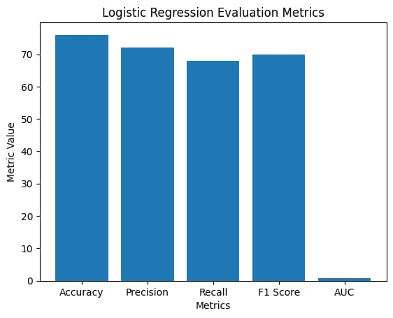
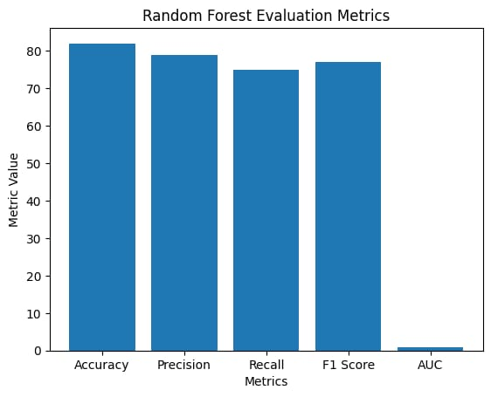
IMPLEMENTATION OF THE PROPOSED SYSTEM
Logistic Regression
Random Forest

Slide 46
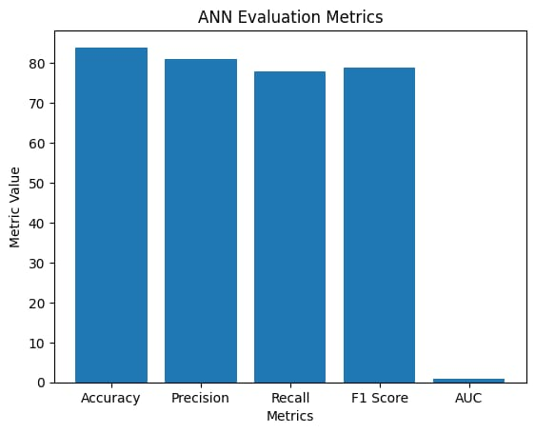
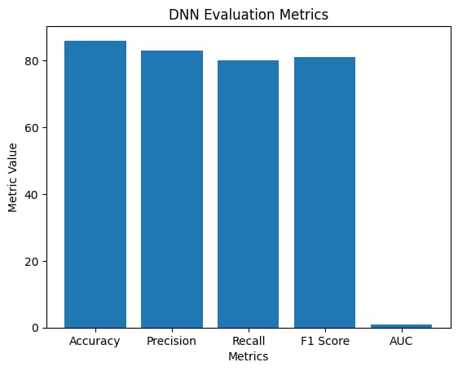
ANN
DNN

Slide 47
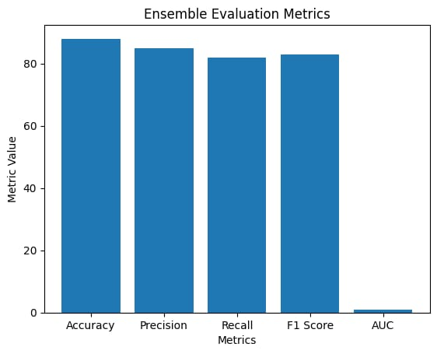
Ensemble

Slide 48
The graphs compare the performance of five machine learning models: Logistic Regression, Random Forest, ANN, DNN, and Ensemble using Accuracy, Precision, Recall, F1-Score, and AUC. Logistic Regression shows moderate performance, while Random Forest and ANN provide better results. DNN achieves higher accuracy and balanced metrics. The Ensemble model performs the best overall, showing that combining multiple models improves prediction accuracy and reliability.

Slide 49
CONCLUSION
This project develops a diabetes prediction system using deep learning and ensemble models. It analyzes patient data such as glucose, BMI, blood pressure, and age to predict diabetes risk. By combining multiple models, the system improves prediction accuracy and helps support early detection and better medical decision‑making.

Slide 50
FUTURE ENHANCEMENT
In the future, this system can be improved by using larger and real‑time medical datasets to increase prediction accuracy. The model can also be integrated with hospital management systems and mobile health applications for easier access by doctors and patients. Additionally, advanced deep learning techniques and IoT‑based health monitoring devices can be incorporated to provide continuous diabetes risk monitoring and personalized healthcare recommendations.

Slide 51
Thank you.

